Slide 1
Tax Law Changes 2018
Notes:
Release 2 Slide changes:
#2 – Corrected additional standard deduction amounts
#22 – TaxSlayer clarification added
#33 – Added reminder casualty and theft losses remain out of scope
#36 – Taxpayers now have until due date of return to secure Social Security Numbers for Qualifying Children. Note added.
#37 – Added bullet: Dependent must be US citizen, US national, or US resident alien.

Slide 2
Standard Deduction
Pub 4012 Tab F-1
Standard deduction increased to
$24,000 MFJ and QW
$18,000 HoH
$12,000 Single and MFS
Additional standard deduction amount for age 65 and older and/or blind increased
$1,600 S, HoH
$1,300 MFJ, MFS, QW

Slide 3
Standard Deduction Single Dependent Under 65
Pub 4012 Tab F
Dependent standard deduction is the greater of
$1,050 or
Earned income plus $350 not to exceed standard deduction for filing status
Single $12,000
Standard deduction worksheet for dependents in Volunteer Resource Guide
Notes:
See Pub 4012 Tab F-2 for dependent standard deduction worksheet

Slide 4
Personal and Dependent Exemptions
Personal exemption deduction reduced to $0
Dependent exemption deduction reduced to $0
$4,150 exemption amount used in qualifying relative gross income test
Notes:
Dependents still claimed on return, however exemption amount reduced to $0. Dependents used for HoH filing status, EIC, CTC, etc.

Slide 5
Filing Threshold
Pub 4012 Tab A Chart A
Filing thresholds for most taxpayers is their standard deduction
See exceptions on next slide
Filing threshold increased by additional standard deduction amount due to age 65 or older and/or blind
Notes:
Additional standard deduction amount for age and blindness - $1,600 ($1,300 MFJ)
Dependent filing threshold Pub 4012 Tab A Chart B

Slide 6
Filing Requirements
Pub 4012 Tab A Chart A
Married taxpayers required to file when combined gross income more than MFJ standard deduction if
Couple lived in same household
Do not file MFS
Married taxpayers any age not living with spouse at end of 2018 or filing MFS must file if gross income at least $5
Notes:
Married taxpayer not living with spouse on date of spouse’s death must file if taxpayer has gross income of at least $5.
Standard deduction increased by additional amount for age and blindness.

Slide 7
Tax Rates and Tax Brackets
Tax rates and brackets modified
New rates: 10% 12% 22% 24% 32% 35% 37%
Lowest rate stays the same
Other rates adjusted downward
Tax brackets adjusted

Slide 8
Student Loan Debt Forgiveness
Student loan debt forgiven due to death or disability of the student no longer included as income

Slide 9
Kiddie Tax in Scope
Kiddie tax has been adjusted
Child’s unearned income now subject to estate and trust tax rates and brackets
Earned income subject to single tax rates
Simpler Bogart calculation for education expenses with unrestricted grants and tax-favored account distributions
In scope for 2018 onward only
Notes:
Vincent Workbook problem deals with Bogart calculator and Pell grant
Kiddie tax in scope for tax year 2018 and onward ONLY
More information about Kiddie Tax located in “Other Taxes” slide deck

Slide 10
ABLE Accounts
Achieving a Better Life Experience (ABLE) account annual contribution limit increased to $15,000
Employed beneficiaries can contribute an additional amount – lesser of
Annual Compensation
Poverty line for one-person household
Notes:
2018 poverty line amount is $12,140 continental U.S., $13,960 Hawaii; $15,180 Alaska
No additional amount is allowed to be contributed if employer contributes to workplace retirement plan on behalf of beneficiary – 401(a), 403(a)(b), 457 plans

Slide 11
ABLE Accounts
Up to $2,000 ABLE account contributions eligible for Saver’s Credit
Contribution must be beneficiary of account to claim credit
Must be age 18 or older
Cannot be dependent or full-time student
Income phaseouts
529 plan funds may be rolled into ABLE account for
Designated beneficiary or
His/her family member
Rollovers count toward annual contribution limit
Notes:
Must be the designated beneficiary of the ABLE account to claim the Saver’s Credit.
Eligible contributions may be reduced by recent distributions from ABLE account.
Rollover contributions to the ABLE account do not qualify for the Saver’s Credit.
529 Example: Parents contributing $10,000 to an ABLE account and rolling $5,000 from a 529 plan into the same ABLE account have met the $15,000 annual contribution limit.

Slide 12
Business Entertainment Expense
Entertainment expenses are not deductible for 2018 onward

Slide 13
Qualified Business Income Deduction
Individual taxpayers can deduct up to 20% of qualified business income (QBI)
A deduction from AGI to arrive at taxable income
In addition to standard or itemized deductions
New for 2018 and in scope
Also referred to as Section 199A deduction
Notes:
Also referred to as Section199A Business Income Deduction

Slide 14
Qualified Business Income
Schedule C income (combined if more than one)
Pass-through entity business income
Such as partnerships, S corporations, limited liability companies
All pass-through entities with business income are out of scope
Real Estate Investment Trust (REIT) 199A dividends
Scope: if taxable income (before the QBI deduction) exceeds $157,500 ($315,000 if MFJ) the return is out of scope
Special rules apply if threshold is exceeded – out of scope
Other scope limitations may kick in at lower limits
Notes:
New box 5 1099-DIV for section 199A dividends eligible for QBI

Slide 15
QBI Deduction Implications
Schedule C is not affected
Self-employed health insurance deduction is not affected
IRA deduction is not affected
Schedule SE tax is not affected

Slide 16
Calculating QBI
Pub 4012 Tab F
20% of the lesser of
Combined qualified business income (for in-scope returns)
Schedule C profit (as shown on Schedule C)
plus qualified REIT dividends (section 199A dividends)
Form 1099-DIV has a new box 5 for 199A dividends
Taxable income in excess of any net capital gain* and before the QBI deduction
Find QBI deduction in Pub 4012 Tab F for TaxSlayer entries
* The term “net capital gain” means the excess of the net long-term capital gain for the taxable year over the net short-term capital loss for such year increased by qualified dividends
Notes:
See Pub 4012 Tab F for TaxSlayer entries

Slide 17
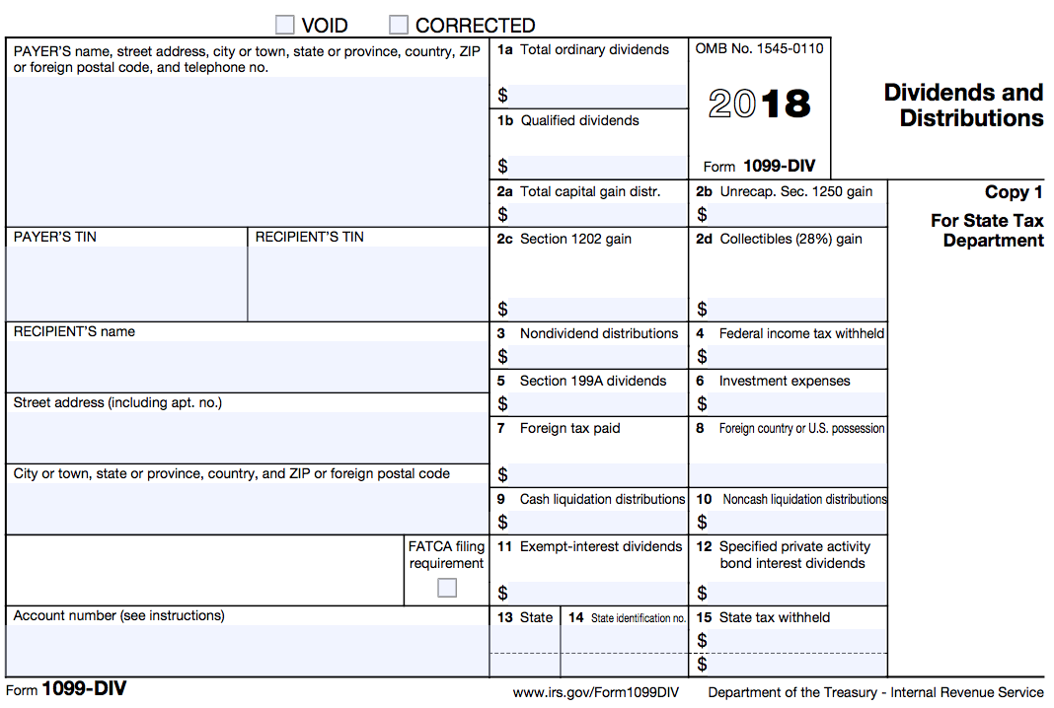
2018 1099-DIV

Slide 18
QBI Deduction Example 1 without Capital Gain
2018 Schedule C profit (QBI): $10,000
2018 taxable income (before QBI deduction): $8,100
QBI deduction is 20% of the lesser of:
Schedule C profit (QBI) $10,000 or
Taxable income (before QBI deduction) $8,100
$8,100 x 20% = $1,620
Notes:
Also referred to as Section199A Business Income Deduction
Remember: Subtract net capital gain from taxable income before calculating QBI deduction

Slide 19
QBI Deduction Example 2 with Capital gain
2018 Schedule C profit (QBI): $10,000
2018 taxable income (before QBI deduction): $8,100
$700 of $8,100 is net capital gain income
QBI deduction is 20% of the lesser of
Schedule C profit (QBI) $10,000 or
Taxable income in excess of net capital gain income (and before QBI deduction) $8,100 - $700 = $7,400
$7,400 x 20% = $1,480
Notes:
Also referred to as Section199A Business Income Deduction
Subtract net capital gain from taxable income before calculating QBI deduction

Slide 20
Self-Employed Health Insurance
Self-employed health insurance deduction in scope
2018 and all open years (by amendment)
Applies to returns with Schedule C profit
Return out of scope for taxpayers entitled to premium tax credits (PTC)
Notes:
This is newly in scope – and can be applied to prior years via an amended return
If a Counselor prepares a return with a Schedule C, they should be well versed in the self-employed health insurance deduction
SE health insurance deduction is iterative when PTC is involved and may require up to three recalculations

Slide 21
Self-Employed Health Insurance
Includes health insurance coverage for
Taxpayer
Spouse
Dependents
Child under 27 (as of year end) even though not the taxpayer’s dependent
“Child” includes stepchild, adopted child or foster child

Slide 22
Self-Employed Health Insurance
Pub 535 page 20
Qualifying insurance includes
Health insurance
Medicare – can be paid by taxpayer or spouse when filing MFJ
Dental, vision, supplemental, limited coverage, etc.
Long-term care (LTC) insurance
Health coverage can be in name of the individual* for in-scope returns
*Individual can be taxpayer, spouse, dependent, or child
Satisfies requirement that it be “established under the trade or business”

Slide 23
Self-Employed Health Insurance
The taxpayer (sole proprietor) cannot be eligible for subsidized coverage
From any employer: own, spouse’s, dependent’s, or child’s
Prior employers do not count
Premiums paid for retiree coverage qualify
Reduce for PSO exclusion, if any
Test LTC plan separately from other employer health plan offers to determine whether subsidized
e.g., if LTC is not subsidized, can claim its cost even though taxpayer (sole proprietor) eligible for subsidized medical coverage
Spouse (if not a proprietor of the business), dependent or child’s coverage can be subsidized
Notes:
Eligible if not subsidized by an employer of the taxpayer, spouse, dependent, or child under the age of 27
LTC deduction limited by age on Sch A and also for SE health insurance deduction.

Slide 24
Self-Employed Health Insurance Deduction Limit
Pub 4012 Tab E
Maximum self-employed health insurance deduction is limited to net profit shown on Schedule C reduced by self employment tax deduction (1/2 of SE tax)
Not reduced for anything else
See Pub 4012 for TaxSlayer input

Slide 25
Self-Employed Health Deduction Example
Schedule C profit: $10,000
Health premium: $2,500
LTC premium: $1,200 (fully allowed base on age)
SE tax deduction $706 (1/2 of $1,413)
SE health deduction limit is $9,294 ($10,000 - 706)
Deduct is $3,700 ($2,500 + 1,200)

Slide 26
Self-Employed Health Deduction Example
Schedule C profit: $3,800
Health premium: $2,500
LTC premium: $1,200 (fully allowed base on age)
SE tax deduction $268 (1/2 of $537)
SE health deduction limit is $3,532 ($3,800 - 268)
Deduct is $532
Remaining $168 can be itemized on Schedule A

Slide 27
Moving Expenses
Moving expense adjustment eliminated except for:
Military members on active duty moving under military orders incident to permanent change of station (PCS)
Military certification required to prepare return

Slide 28
Alimony
Alimony treatment for new or modified* orders after 12/31/18
Alimony payments not deductible
Alimony received not taxable
Not compensation for IRA purposes
Alimony under existing orders are grandfathered
Alimony payments continue to be deductible
Alimony received continues to be taxable
Compensation for IRA purposes
*Modification must specify that new rules intended to apply
Notes:
Modified orders will apply new law if stated in the modification

Slide 29
Medical Expenses
2018 AGI threshold for deducting medical expenses 7.5%
2019 AGI threshold for deducting medical expenses 10%

Slide 30
Itemized Deduction for Taxes
Combined itemized deduction for taxes limited to $10,000 ($5,000 MFS)
Includes state and local income or sales tax (SALT) and property taxes
Taxes deducted on Schedules C, E or F not subject to $10,000/$5,000 limitation
Foreign real estate tax no longer deductible on Schedule A
Notes:
Returns with Schedule E land rentals and additional Schedule E expenses – like property tax deductions – are out of scope. It may be beneficial for taxpayers to have their returns prepared by a paid preparer when Schedule A SALT limited to $10,000.

Slide 31
Home Mortgage Interest
Home mortgage interest limitation reduced
Acquisition debt incurred on or after December 15, 2017
Interest on acquisition debt up to $750,000 ($375,000 MFS) going forward
Acquisition debt incurred prior to December 15, 2017 is grandfathered
Taxpayer with binding written contract before December 15, 2017 also grandfathered if purchase completed before April 1, 2018
Deductible interest remains limited to mortgage interest on up to $1 million ($500,000 MFS) of acquisition debt

Slide 32
Home Mortgage Interest (cont)
Limits apply to the combined amount of loans used to buy, build or substantially improve taxpayer’s main home or second home (called acquisition debt)
Interest on home equity debt that is not acquisition debt is no longer deductible as home mortgage interest
regardless of when debt was incurred
Interest on home equity debt remains deductible if used to buy, build, or substantially improve residence (subject to the applicable limitation)

Slide 33
Home Mortgage Interest (cont)
To be deductible
Loan must be secured by the home (main home or second home)
Cannot mortgage main home to buy a second home
Loan must not exceed cost of home

Slide 34
Charitable Contributions
50% limitation for cash contributions to qualified charities increased to 60% of AGI
5-year carryover to the extent exceed 60% out of scope
No charitable deduction allowed for payment to higher education institution in exchange for right to purchase tickets/seating at athletic event

Slide 35
Casualty and Theft Losses
Personal casualty and theft losses deduction eliminated
Losses for presidentially-declared disaster area still allowed
2017 hurricane disaster losses remain deductible
Casualty and Theft Losses remain out of scope

Slide 36
Deductions Subject to 2% Limitation
All deductions subject to 2% AGI limitation have been suspended 2018 – 2025
No longer eligible to deduct employee business expenses
No longer eligible to deduct investment expenses

Slide 37
Itemized Deductions
Miscellaneous deductions not subject to 2% still in effect
Gambling losses
Repayments in excess of $3,000 (see Payments lesson)
Loss on annuity at death of annuitant
Certain work-related expenses for person with a disability
High income taxpayers no longer subject to limit on itemized deductions

Slide 38
Child Tax Credit
Child tax credit (CTC) and additional child tax credit (ACTC) increased
Qualifying child must have SSN by due date of return including extensions
This is a change
Maximum credit increased to $2,000 per qualifying child
Refundable up to $1,400
Earned income threshold decreased to $2,500 - down from $3,000
Income phase out begins at $200,000 ($400,000 MFJ)
Notes:
Parents of children with SSN can have ITIN and be eligible for the credit. Children can no longer have ITIN to qualify for child tax credit.
Taxpayers have until due date of the return including extensions to secure a social security number for their qualifying children.

Slide 39
Credit for Other Dependents
New credit for other dependents
$500 credit for each dependent not qualified for child tax credit
Nonrefundable
Same income phase out begins at $200,000 ($400,000 MFJ)
Dependent may have ITIN
Dependent must be U.S. citizen, U.S. national, or U.S. resident alien
Dependent may not be spouse of taxpayer
Notes:
Does not have to be a qualifying child. Qualifying relative also eligible for new credit. Taxpayer/spouse may have ITIN

Slide 40
ACA
Affordability percentage for exemption purposes decreased to 8.05%
Federal poverty lines updated
Shared responsibility payment amount and percentage unchanged for 2018
Reduced to zero beginning tax year 2019

Slide 41
Act 529 Plans K-12 Eligible
Act 529 plans can be used for K-12 expenses
Distributions up to $10,000 per year can be used for tuition incurred at a public, private or religious elementary or secondary school
$10,000 is per student limit
Check if state conforms

Slide 42
AOC Qualified Expense Update
Computers may be allowable educational expense for AOC
Majority of schools rely on internet communication – thus computer “needed” while not specifically required
Keep expense receipts and documentation of electronic submission guidelines
Generally in course syllabus
Notes:
Pub 970 Tax Benefits for Education: … expenses for books, supplies, and equipment needed for a course of study are included in qualified education expenses whether or not the materials are purchased from the educational institution.
There is increased demand on students in degreed programs to receive and submit assignments, collaborate in working groups and receive grades electronically.

Slide 43
Expired Benefits Not Renewed
Deduction for private mortgage insurance (PMI)
Exclusion from gross income of qualified principal residence indebtedness cancelation
Deduction for qualified tuition & fees
Credit for nonbusiness energy property (residential energy credit)

Slide 44
Tax Law Changes

